Slide 1


Movement Primitive Analysis for Movement Recognition A Neuro-AI Pipeline Using Markerless Motion Capture
Arefeh Farahmandi
April 2025

Slide 2
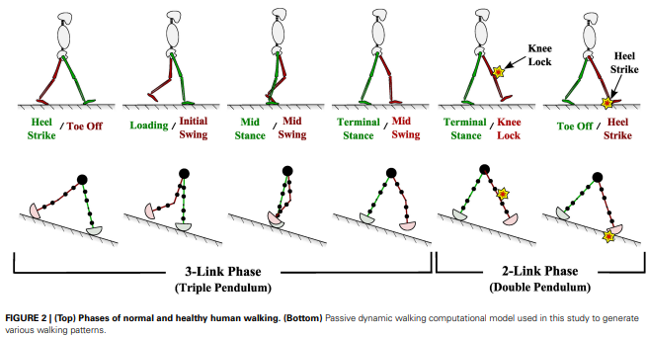
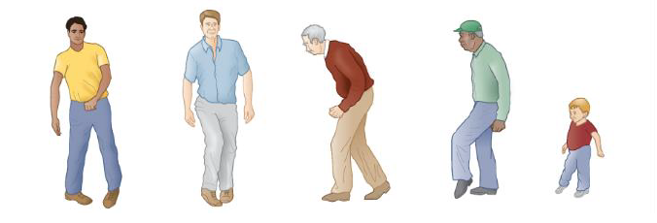
Goal
Understand the principles underlying movement perception in order to identify the movement characteristics that allow us to distinguish between normal and abnormal movements
Long-term goal : A Framework which distinguish abnormal movement (score - severity estimation) + description about affected joints or sources
Question
How we perceive – recognize - evaluate different movements?
Handžić & Reed (2015)

Slide 3
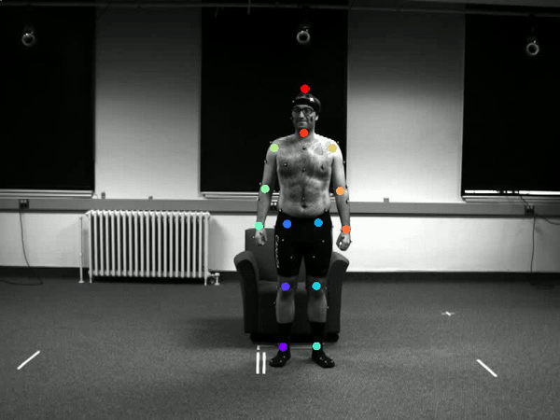
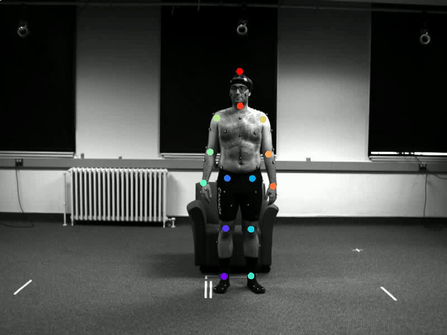
Part 1: Movement classification
Question: Can we identify movement characteristics that helps to distinguish different movements?
-Use DeepLabcut for simple Videos to extract 2D pose estimation
-New available toolbox:
1- 3D pose estimation with videos of 2 camera
2- joint velocity and acceleration
Notes:
Video instead of 3d motion
21 movement daily activities
-enable computer vision tools
Advantage of this model to use video

Slide 4
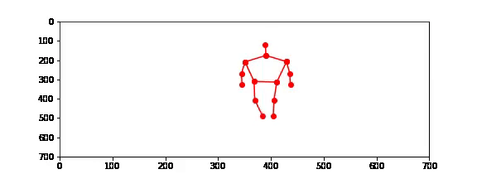
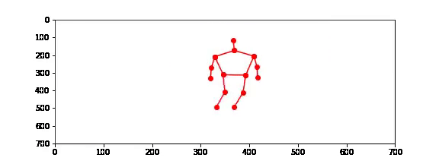
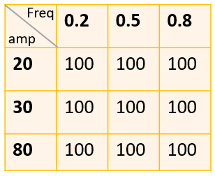
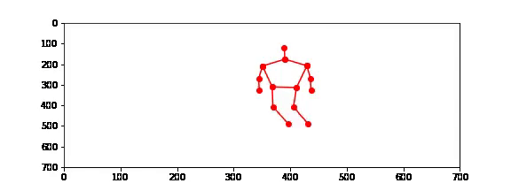
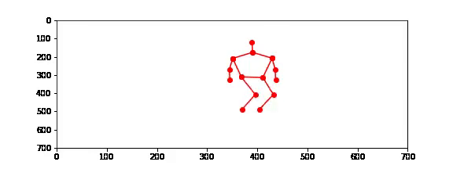
Perturbation
How perturbing one specific joint change the classification result between “walking” & “jumping jacks”?

Slide 5
Issues
Does not capture temporal aspect of movement
Does not consider 3D pose
Only has normal movement videos
Limited ways to assess movement patterns
Does not incorporate movement principles in modeling

Slide 6
Part 2: Movement Primitives Models
Movements decomposed into fundamental building blocks called movement primitives, which the nervous system combines flexibly to produce coordinated actions. (Knopp et al. 2020)
Temporal Movement Primitives (TMP): Models stereotyped temporal patterns of movement parameters like joint trajectories
Dynamic Movement Primitives (DMP): Describe the elements of movement as attractors of a dynamical system, Uses differential equations with forcing functions modeled as weighted sums of Gaussian basis functions
Gaussian Process Dynamical Model (GPDM): A state-space model which learns a dynamical mapping in a latent space of the whole-body movement.
Coupled GPDM (cGPDM):Extension of GPDM to enable modularity, different dynamical models for different body parts
Notes:
Tmp because: take time into account. Easy to interpret.

Slide 7
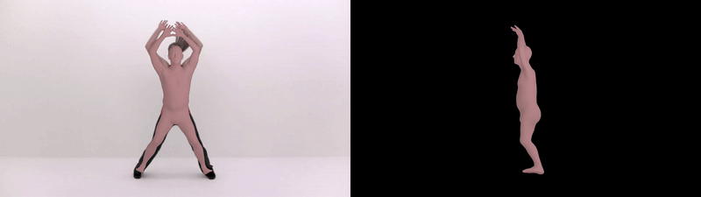
Challenges
TMP
TMP model requires 3D pose motion data
VIBE : requires multiple view videos
DeepLabCut : requires multiple Camera Calibration
Data!
Simple Video
3D pose
Movement primitives
Kocabas et al (2020)
Notes:
VIBE predicts the parameters of SMPL body model for each frame of an input video.
Patient data
is very limited…

Slide 8
Movement Recognition
What are primitives that distinguish different movements?
Are those primitives aligning with our movement perception?
Can we use these primitives to enhance ML applications?
Movements decomposed into fundamental building blocks called movement primitives, which the nervous system combines flexibly to produce coordinated actions. (Knopp et al. 2020)

Slide 9
Process
TMP model
TMP model requires 3D pose motion data
VIBE : requires multiple view videos
DeepLabCut : requires multiple Camera Calibration
Mmpose : Powefool toolbox for 3D pose extraction
Simple 2D Video
3D pose
Motion Capture
Movement primitives
Notes:
VIBE predicts the parameters of SMPL body model for each frame of an input video.
Patient data
is very limited…

Slide 10
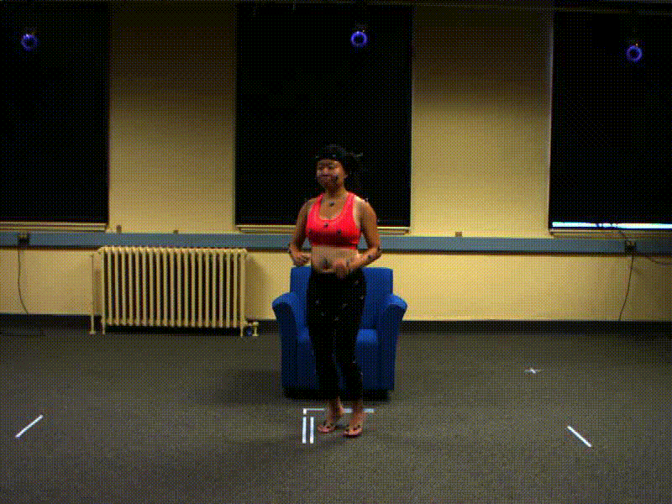
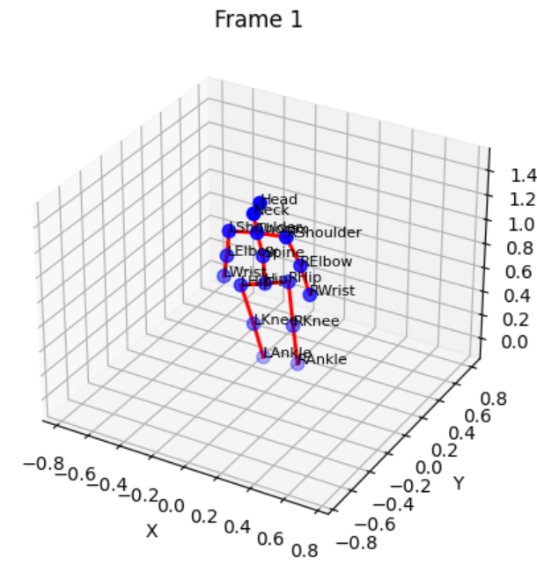
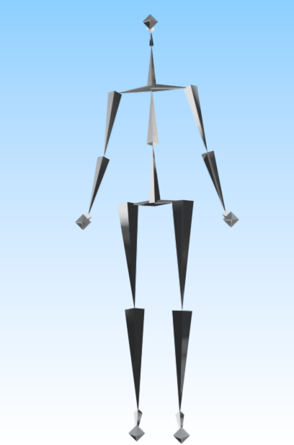
Data Processing
1-Original 2D video
2-MMpose 3D extraction
3-Motion Capture .bvh

Slide 11
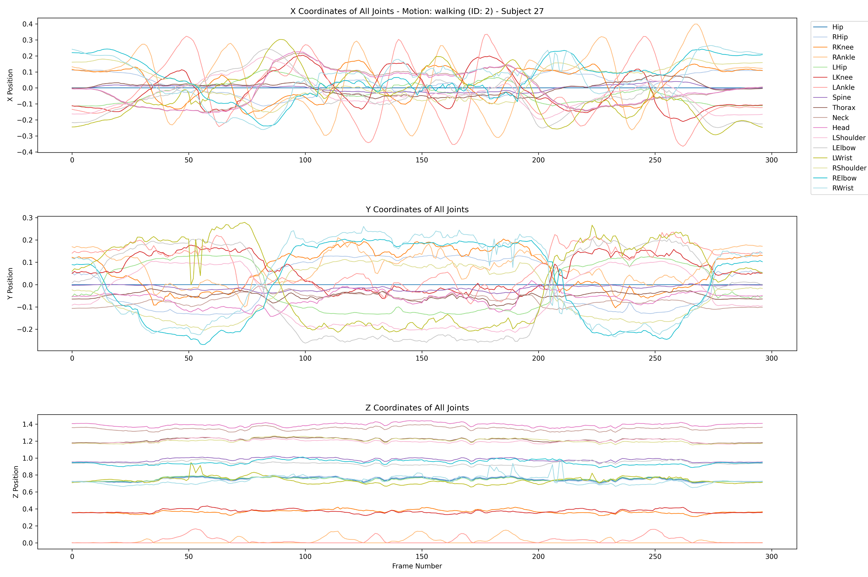
3D data pose
Motion: walking
Subject_id : 27

Slide 12
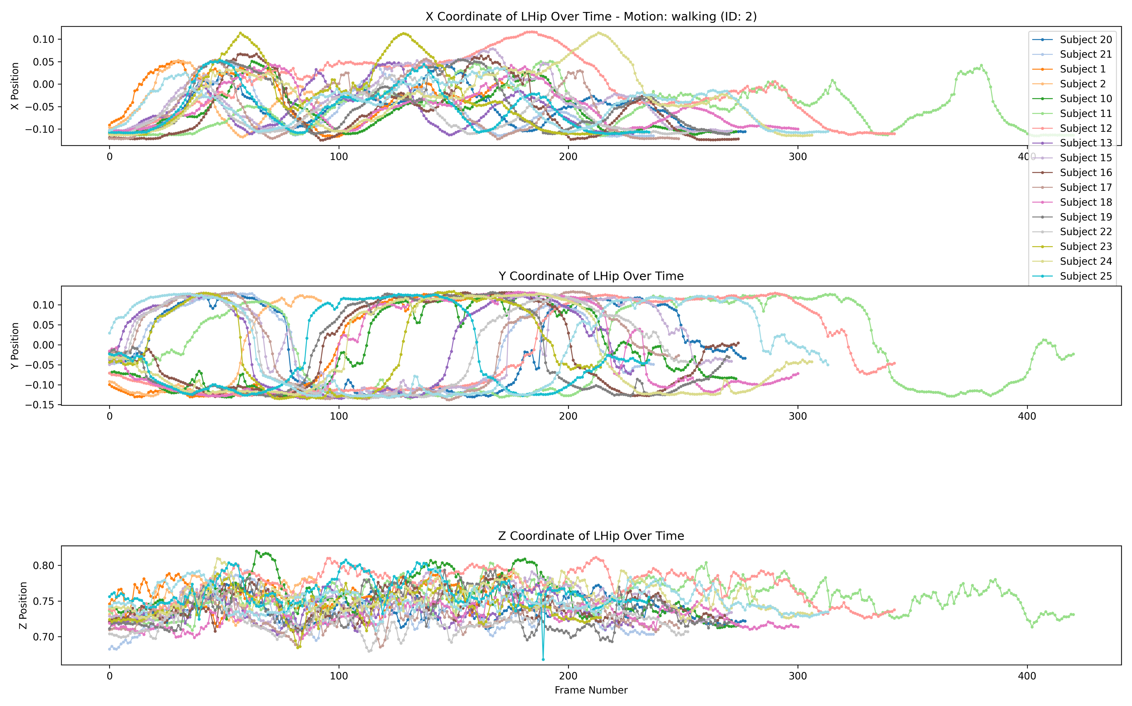
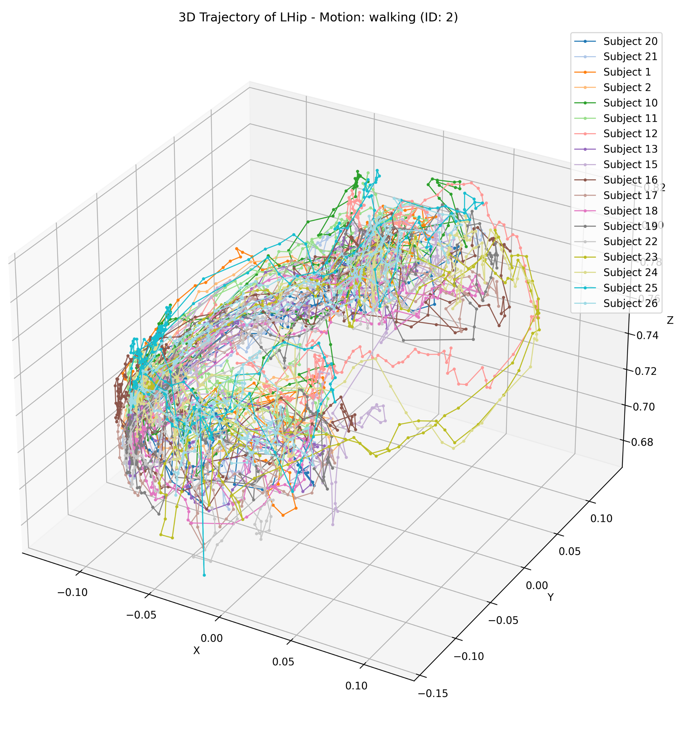
Joint trajectory across all subjects
Joint: Left Hip
Motion: Walking

Slide 13
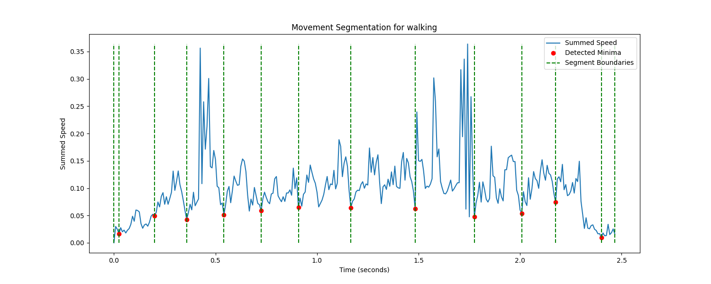
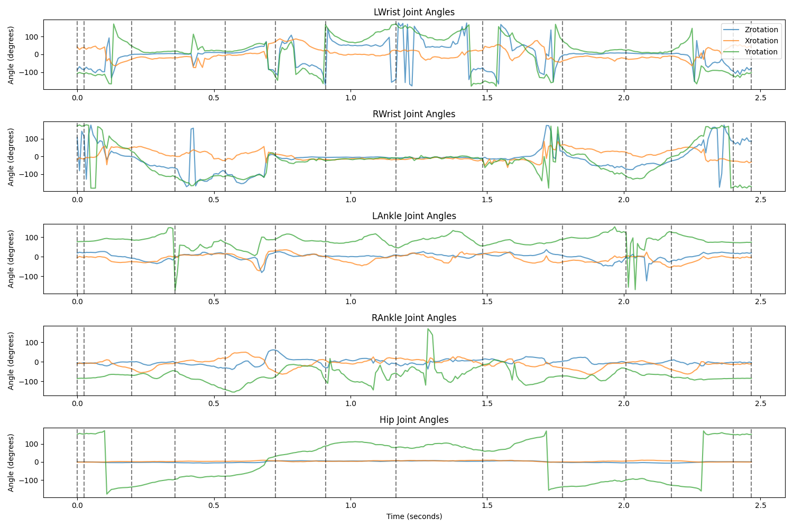
Data Segmentation
Partition sequences into segments in time
Boundaries: minima of summed speed of the wrist and foot markers limited to a min distance of 160 ms (19 frames)
Notes:
The joint angles of each movement sequence were partitioned into segments in the temporal dimension.

Slide 14
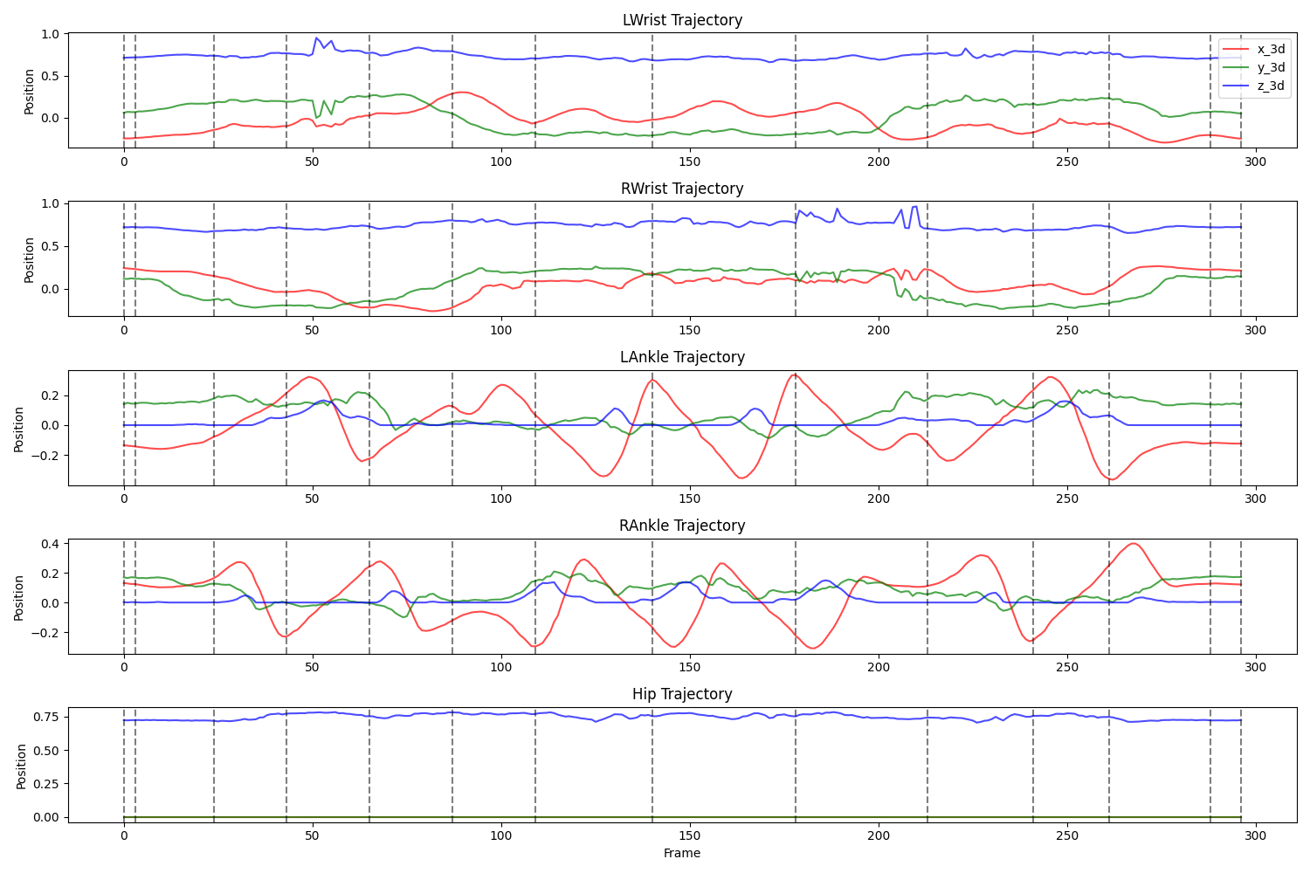
Data Segmentation

Slide 15
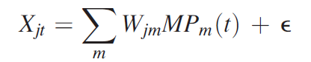
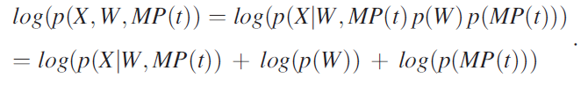
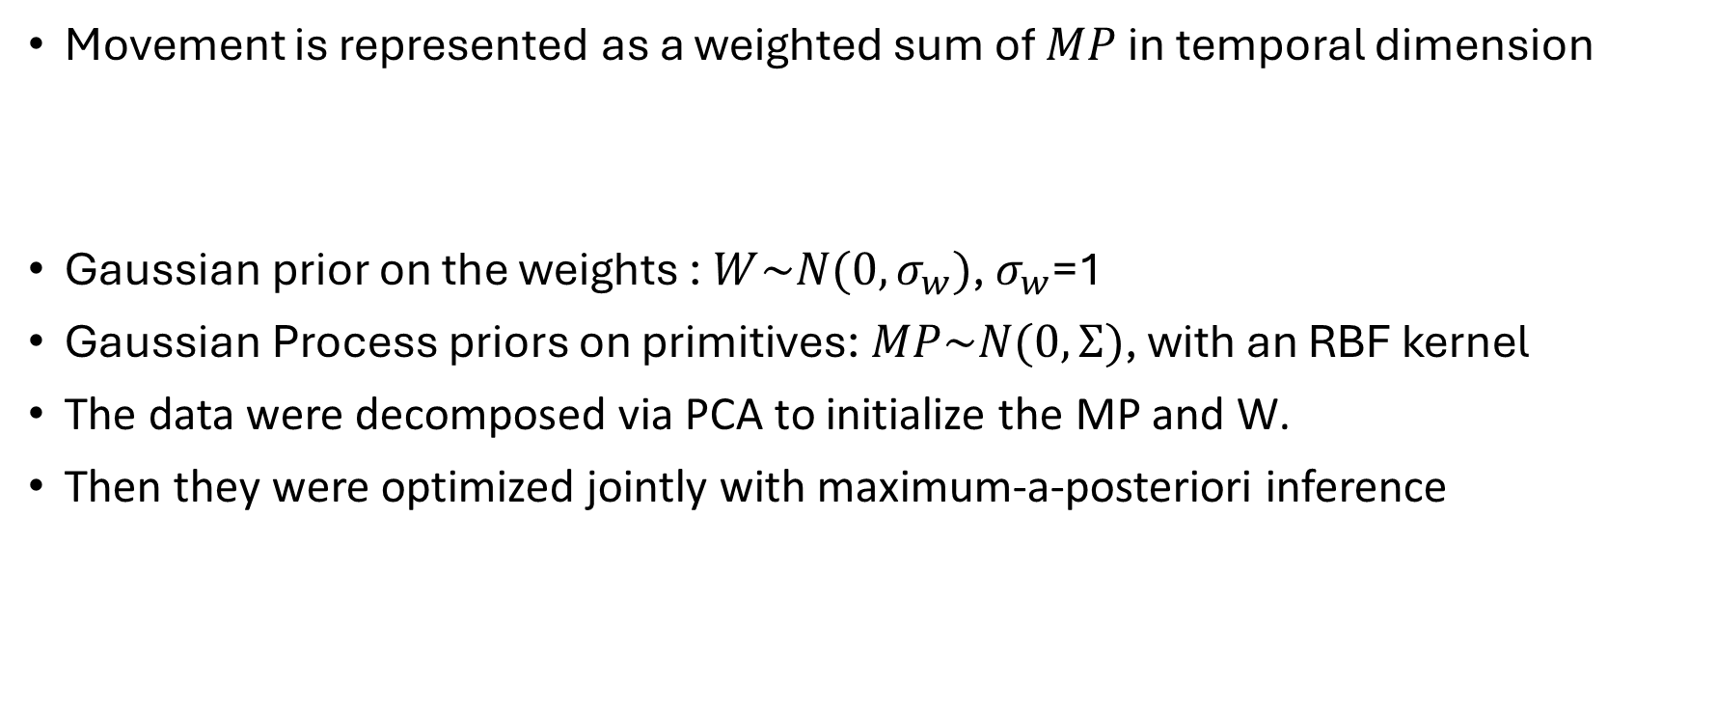
TMP model
Movement is represented as a weighted sum of $MP$ in temporal dimension
Gaussian prior on the weights : $W\sim N(0, σ_{w})$, $σ_{w}$=1
Gaussian Process priors on primitives:$MP\sim N(0,Ʃ)$, with an RBF kernel
The data were decomposed via PCA to initialize the MP and W.
Then they were optimized jointly with maximum-a-posteriori inference
Notes:
The model parameters, i.e., the
weights and primitives,

Slide 16
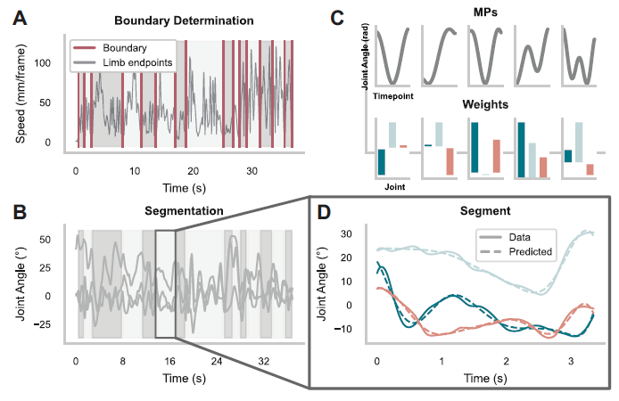
TMP model
Leh et al (2023)

Slide 17
TMP model
Steps that didn’t work:
Feed all motions to one TMP model once: VAF = 30%
Limited data samples (40 subjects for now)
Current stage:
Single motion extraction for each subject
Segmentation
Feed all segments into a TMP model for each motion
VAF = 70-80%
Notes:
Based on the paper, e should get 95% VAF

Slide 18
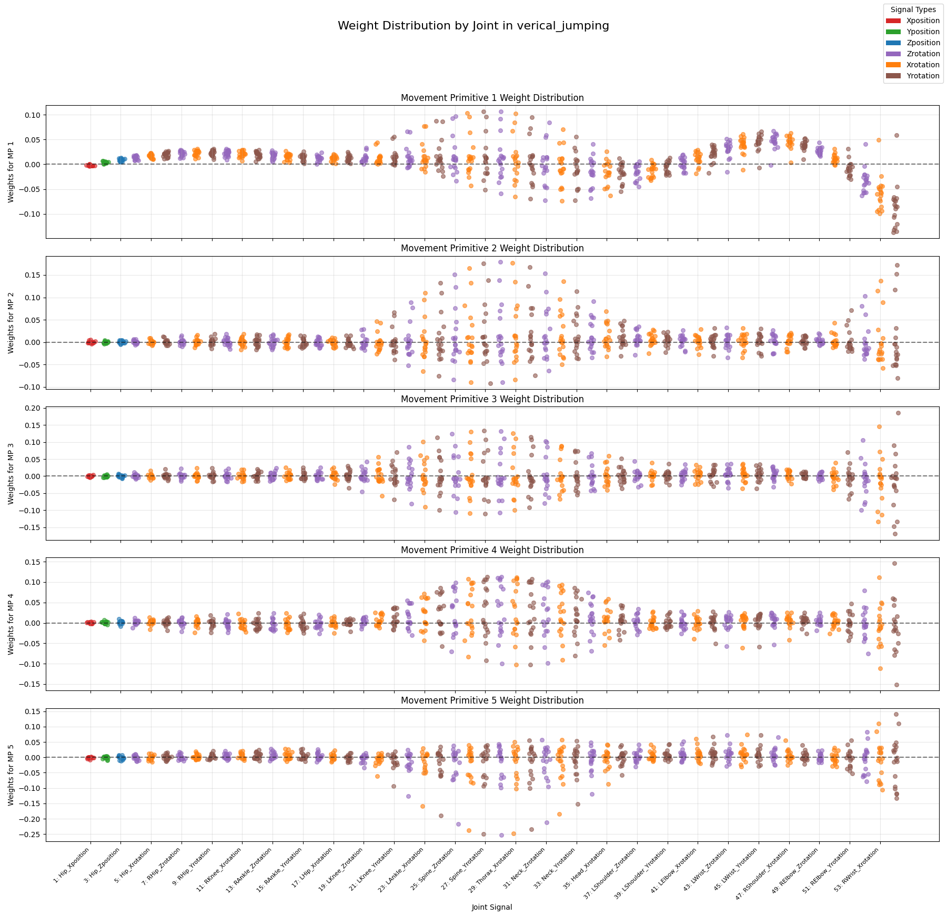
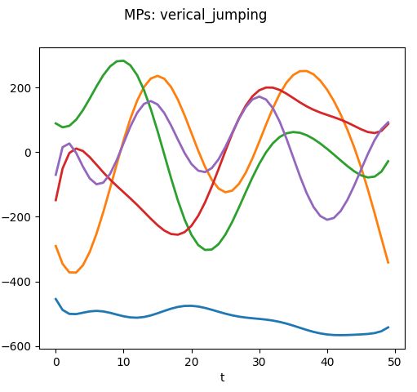
Movement Primitives

Slide 19
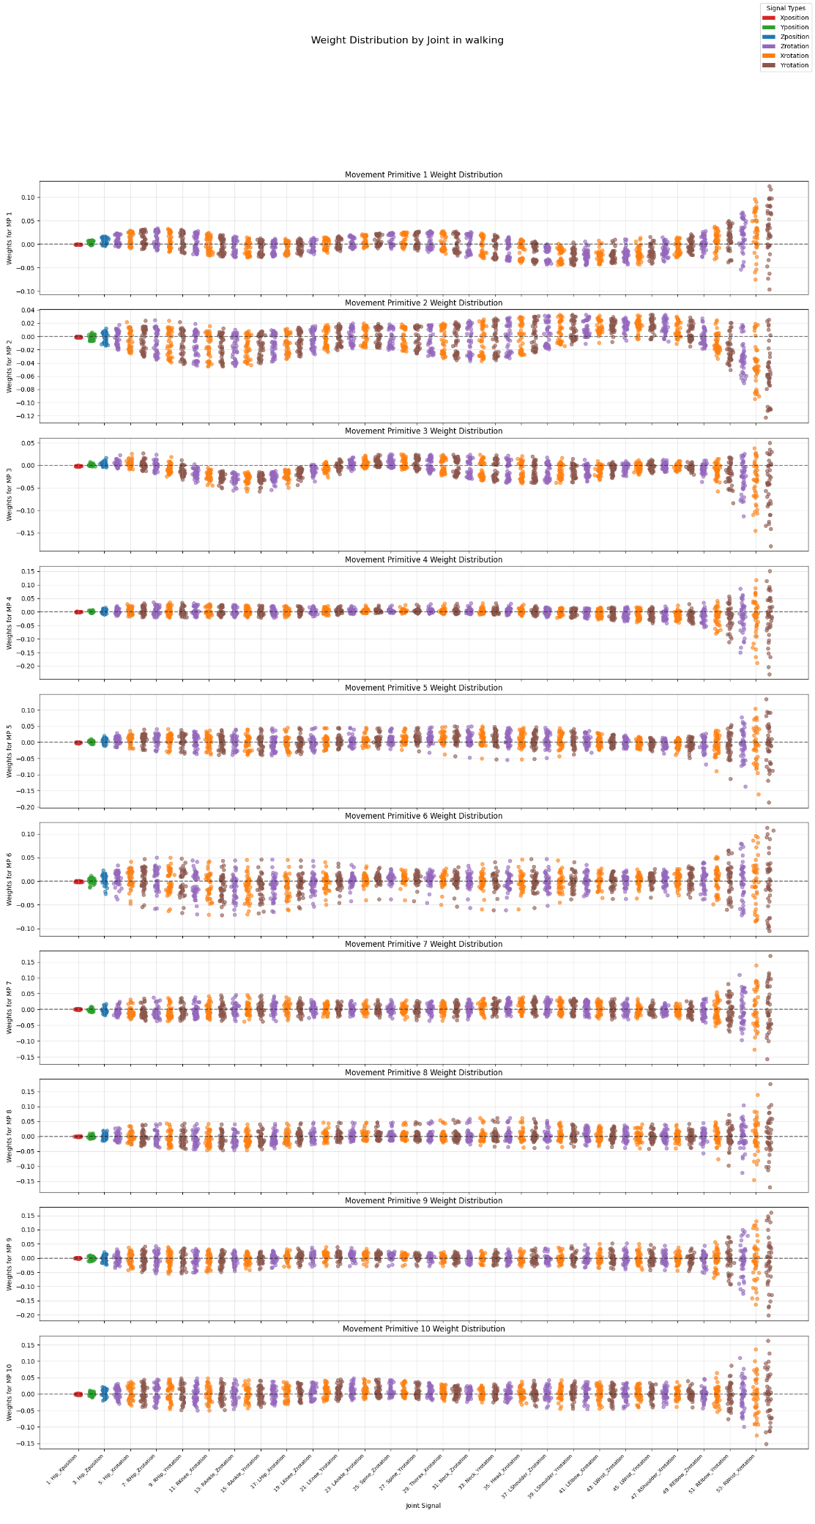
Weights distribution

Slide 21
End

